Slide 1
Raytracing in One Semester
Assignment 0

Slide 2
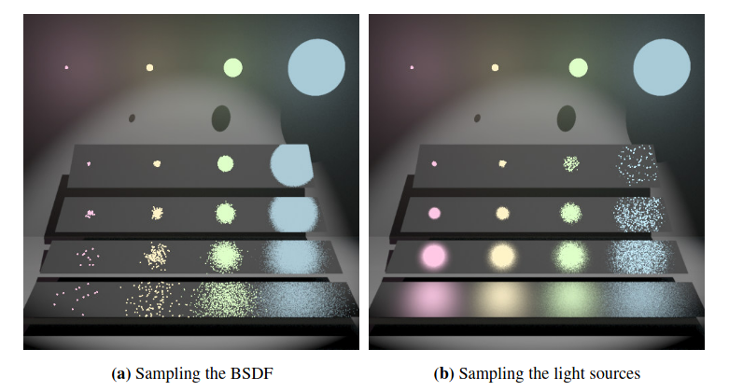
Multiple Importance Sampling
Sampling BSDF gave increasingly worse results for small light sources on rougher materials. Sampling the light sources themselves made big light sources suffer in smooth materials.
Best idea was to combine the two distributions with weighting based on their PDF (importance) for that sample.

Slide 3
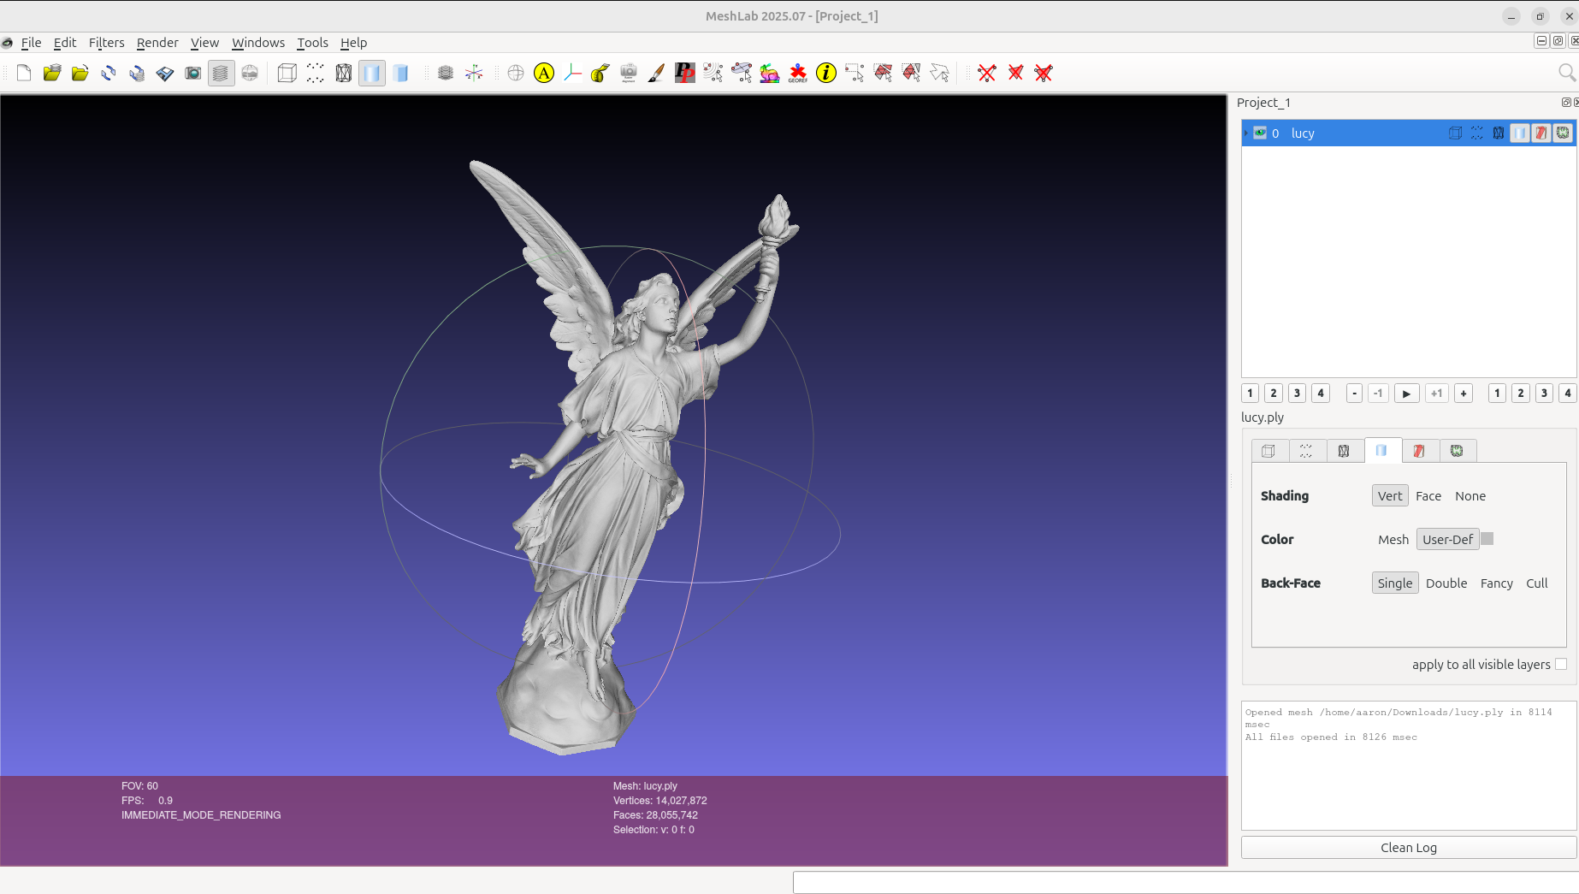
MeshLab

